Slide 1

Chitkara University Institute of Engineering & Technology
Department of Computer Science and Engineering
IP PROJECT
Expense Tracker App
Team Name: ELITES
Group: 11
Guide Name: Dr Ochin Sharma
Semester : 6th
Session : July – Dec 2024
Name :ALOK KUMAR , Roll No:2110991632
Name :GYAN GOURAV , Roll No:2110991707 Name :VISHU MITTAL , Roll No:2110991551 Name :VISHAL VERMA , Roll No:2110991546

Slide 2


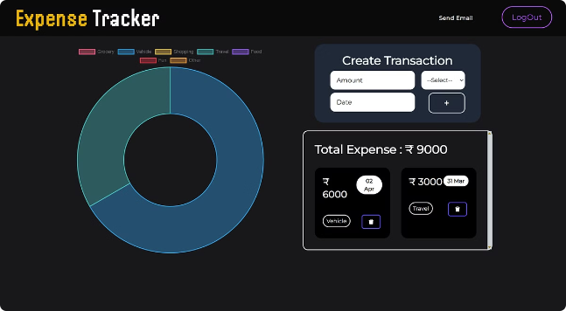
Introduction to the Financial Calculator Project
This project aims to develop a comprehensive MERN stack-based financial calculator application. The application will provide users with a range of financial tools and functionalities to help them manage their finances more effectively.

Slide 3
Overview of the MERN Stack
MongoDB
Express.js
React.js
The NoSQL database used to store financial data and user information.
The backend framework that handles API calls and server-side logic.
The frontend library used to build the user interface and interactive components.

Slide 4
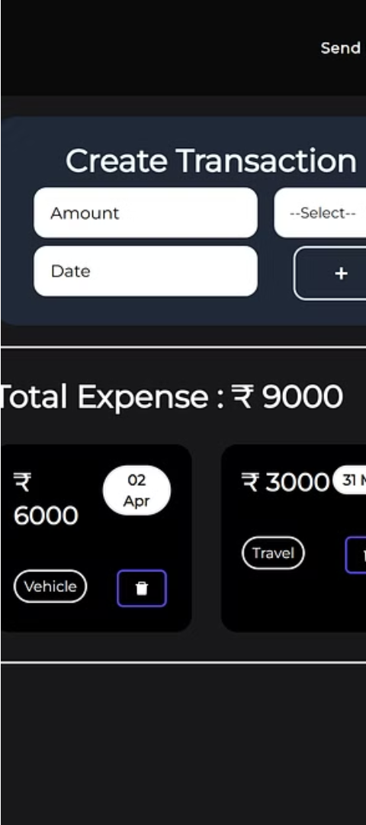
Front-End Functionality
1
Intuitive User Interface
2
Interactive Calculators
The front-end will feature a clean, modern, and responsive design to provide a seamless user experience.
Users can access a range of financial calculators, such as mortgage, loan, and investment calculators.
3
Personalized Dashboards
Users can create custom dashboards to track their financial goals and progress.

Slide 5
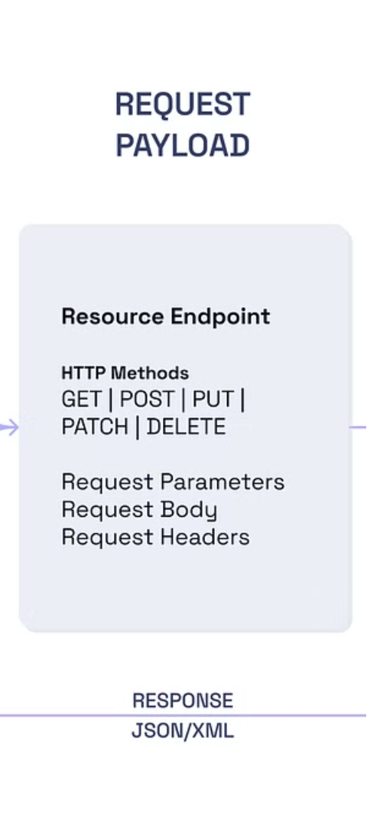
Back-End Functionality
Secure Authentication
Data Storage and Retrieval
Users can securely register, log in, and manage their account information.
The backend handles the storage and retrieval of user financial data in the MongoDB database.
API Endpoints
The Express.js backend provides API endpoints for the front-end to interact with the application's functionality.

Slide 6
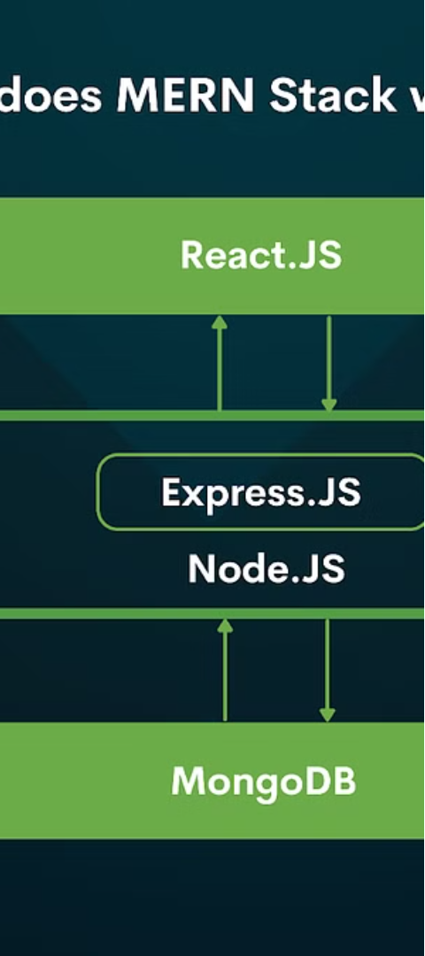



Integration of Front-End and Back-End
Data Synchronization
The front-end communicates with the back-end via API calls to ensure real-time synchronization of user data.
State Management
React.js handles the state management of the front-end, enabling seamless updates and interactions.
Responsive Design
The application's responsive design ensures a consistent and optimized user experience across various devices.

Slide 7
Key Features and Capabilities
Comprehensive Calculators
Data Visualization
Personal Budgeting
Users can generate visual representations of their financial data, such as charts and graphs, to gain better insights.
The app provides tools for users to create and manage personalized budgets, track expenses, and monitor their financial health.
The application offers a wide range of financial calculators, including mortgage, loan, investment, and retirement planning tools.

Slide 8



Challenges and Lessons Learned
Scalability
Security
Integration
Ensuring the application can handle increasing user traffic and data demands.
Implementing robust security measures to protect user financial data and privacy.
Seamlessly integrating the front-end and back-end components for a cohesive user experience.

Slide 9

Conclusion and Future Enhancements
1
Ongoing Improvements
The team will continuously refine and enhance the application based on user feedback and emerging trends in the financial software industry.
2
Expanded Functionality
Future updates may include integration with external financial institutions, advanced analytics, and personalized investment recommendations.
3
Increased Accessibility
The team aims to make the application more accessible to users with diverse needs, including those with disabilities or limited financial literacy.

